Slide 1


Analysis on Facebook Utilization
Presented by: Dipali Dhope
Unrestricted
Unrestricted
Unrestricted

Slide 2
Agenda
Problem statement
Exploratory Data Analysis
Conclusion

Slide 3
Problem statement
Facebook, Inc. is an American social media conglomerate corporation, founded on February 2004 by Mark Zuckerberg.
People from all age groups relate to each other through Facebook.
However, there are certain differences in the way of using it, for example sending friend requests, sending likes, comments etc.
Let's say they want to study and analyze these differences and identify the pattern out of it.
This study will help the company to utilize these patterns in the next set of iteration development.

Slide 4

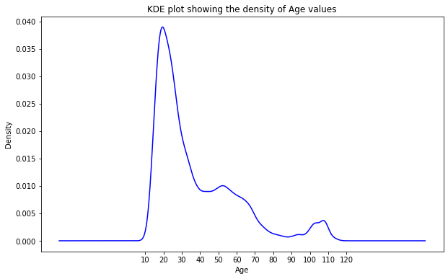
Which Age group uses Facebook the most?
Highest density is at age group of 10 to 40 with peak at 20.

Slide 5
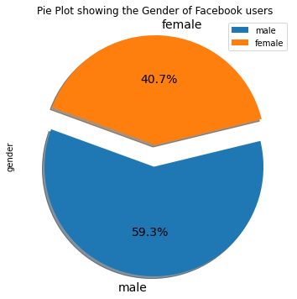
Which gender uses Facebook most?
Male users are more compared to female users.

Slide 6
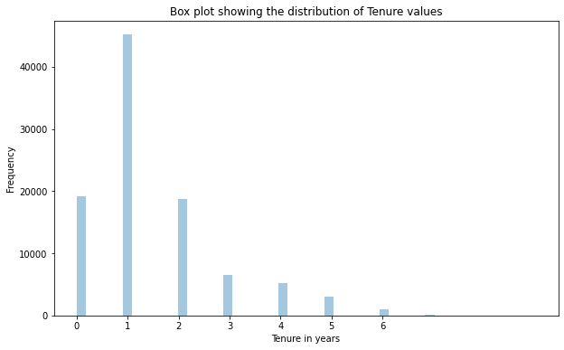
Determine the Tenure for which people use Facebook most
Maximum users are using Facebook since less than 2 years.

Slide 7
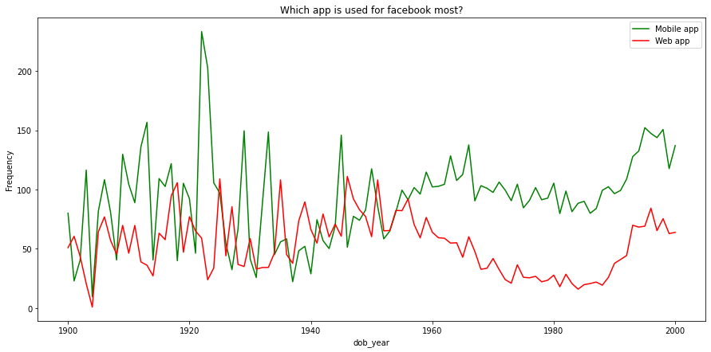
Which usage is more via Mobile app or Web app?
Mobile app seems to be more popular across all age group of Facebook users. However young generation clearly prefers Mobile app over Web app.

Slide 8
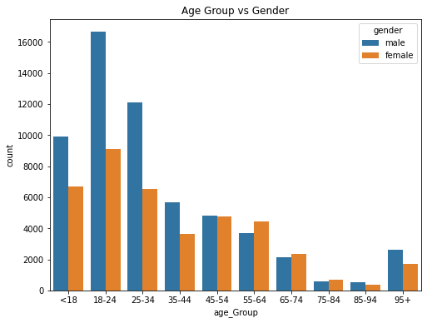
Relationship between age vs gender
We can clearly see that Male users are predominantly more than Female users till the age group of 44 years

Slide 9
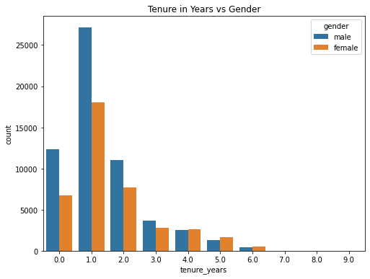
Relationship between tenure vs gender
Male users are predominantly more than Female users when considering newly registered users till the tenure of 2 years.

Slide 10
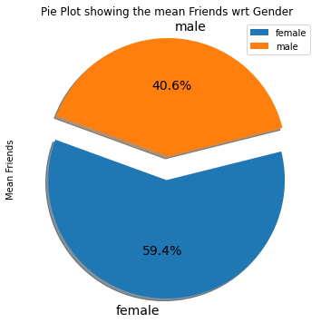
Relationship between number of friends vs gender
Female users are more than Male users when considering number of Friends.

Slide 11
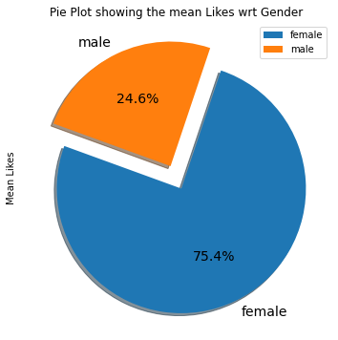
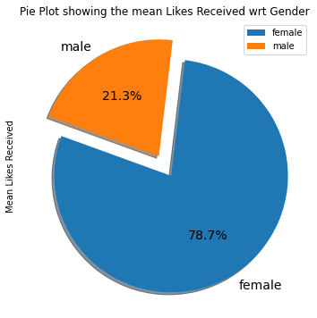
Relationship between likes vs gender
Female users are more than Male users when considering number of Likes sent & received.

Slide 12
Conclusion
Facebook is more popular among young generation and male users compared to females.
Mobile app is preferred over web app across all users.
Many users have started using Facebook recently as there are many users within span of 2 years.
Number of Friends as well as Likes sent & received is high in Female users compared to male.
Actionable Insights
Increase the popularity in old generations by providing some activities of interest to old generation.
Mobile app being more popular, more features can be added for mobile users.
Introduce some Social Games, Friend anniversaries, Birthdays to increase social interaction between like minded people.
Female users seems to be more active even though less in number. Try and make Facebook popular among female users.

